Slide 1

Crop Disease Detection using Machine Learning
Vidarbha Youth Welfare Society’s Prof. Ram Meghe Institute of Technology and Research, Badnera – Amravati
Department Of Computer Science & Engineering
Presented By:
B3
Project Guide:-
Dr. N. S. Dandge

Slide 2
Outline
Introduction
What is crop Disease Detection?
Why we use crop Disease Detection System?
Purpose, Scope & Objectives
Literature Survey
Problem statement
Design Flow (working, DFD)
Applications
Advantages
Disadvantages
Conclusion
Future Scope

Slide 3
Introduction
crop disease detection is a technology that uses machine vision equipment to acquire images of crops and judge whether they have diseases or pests.
It can help farmers to identify and treat crop diseases and pests in a timely and accurate manner, which can improve the yield and quality of crops

Slide 4
What is crop Disease Detection System?
Online crop Disease Detection System is a web application in which administrators will register various images of the crop diseases.
So, here we present our system.
Administartor will train the various crop dataset and train using CNN algorithm.
If farmer wants to search any disease on the crops, he will upload the image of the infected area of the crop and our model will predict which is the cause of the disease and recommend some remedies to it.

Slide 5
Why we use crop Disease Detection System?
crop Protection
Early Detection
Food Safety
Economic Impact
Efficiency and convineance

Slide 6
Purpose, Scope & Objective
To detect the crop disease.
After recognition of disease suggest some remedies (pesticides) to prevent that disease.
To upload photos and generate dataset for disease Prediction and recommend the remedies.
To develop an online crops disease detection system.
To implement CNN algorithm for disease prediction.
To implement remedies and preventive measures recommender system.
Purpose
Scope
Objectives

Slide 7
Literature Survey
Autor | Paper | Method used | Advantages | Disadvantages
1. Barbedo, J. G. A. (2019) | “Factors influencing the use of deep learning for crop disease recognition." Biosystems Engineering, 180, 45-55. | “Factors analysis" to examine the influences on deep learning for crop disease recognition. | To understand the determinants that affect the utilization of deep learning for crop disease recognition. | It doesn't directly provide solutions but rather identifies influencing factors.
2. Cruz, A. C., Fuentes, A., & Yoon, S. (2019) | "A novel image-based automatic recognition system for crop diseases." Computers and Electronics in Agriculture, 157, 417-428. | “Novel image-based automatic recognition system" for identifying crop diseases. | Development of an effective automated system for crop disease recognition using images. | A high cost of implementation is one of the most significant disadvantages of this new technology

Slide 8
Author | Paper | Method used | Advantages | Disadvantages
3. Ferentinos, K. P. (2018). | "Deep learning models for crop disease detection and diagnosis." Computers and Electronics in Agriculture, 145, 311-318. | “Deep learning models" for crop disease detection and diagnosis. | Enhanced accuracy and efficiency in crop disease detection | Dependence on data quality
4. Sharma, P., Dhillon, G. S., & Singh, D. (2018) | "Disease detection of a crop leaf using Image segmentation with color based K-means clustering." | "Image segmentation with color-based K-means clustering" for crop leaf disease detection. | ability to accurately detect crop leaf diseases through the use of color-based K-means clustering in image segmentation. | truggle with complex backgrounds or lighting conditions

Slide 9
Problem Statement
crop diseases pose a significant threat to global food security and agricultural sustainability. Early detection and precise identification of these diseases are essential to minimize crop losses, reduce the need for chemical interventions, and ensure sustainable food production. The problem statement for this seminar revolves around developing an advanced crop disease detection system for precision agriculture.

Slide 10
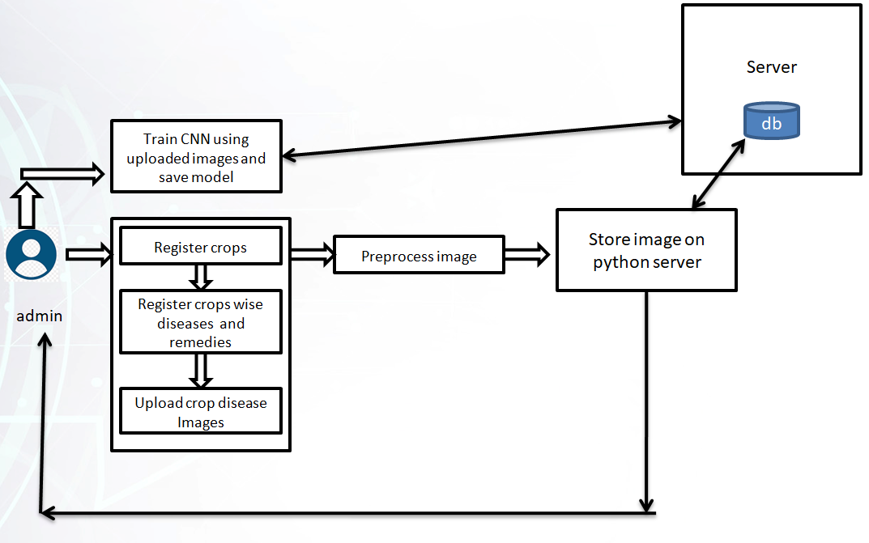
Design Flow Admin Working:
Working at Admin’s side

Slide 11
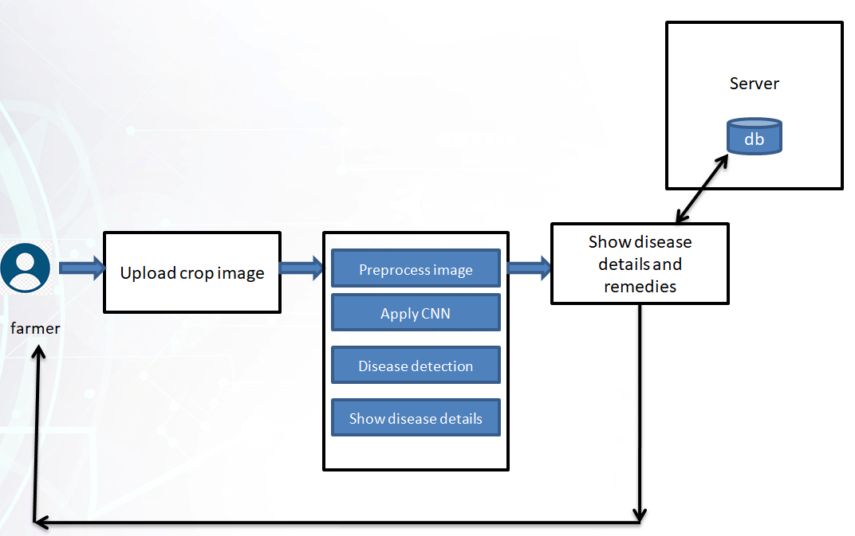
Farmer’s Working:
Working at Farmer’s side

Slide 12
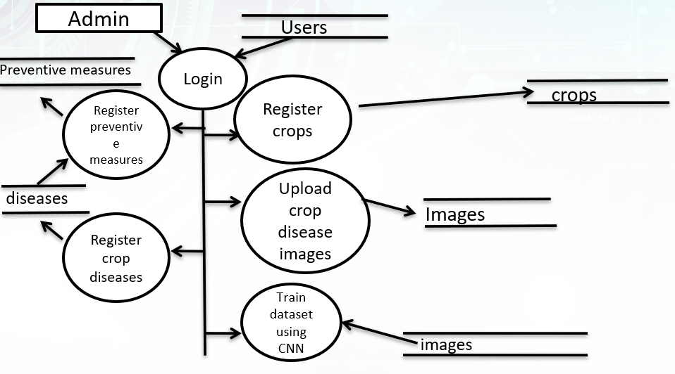
Data Flow Diagram

Slide 13
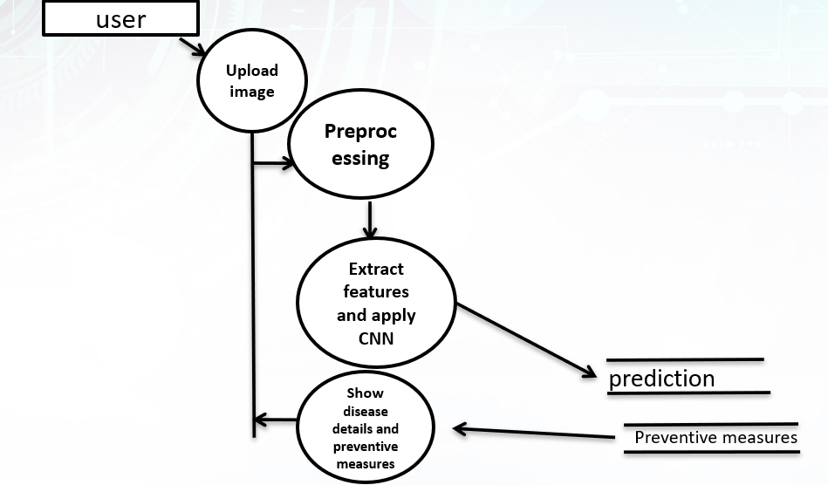

Slide 14

Algorithm Used: CNN
CNN Working

Slide 15
CNN Image recognition steps
Input Layer
Convolutional Layers
Pooling Layers
Fully Connected Layers
Output Layer

Slide 16
Applications
This proposed architecture of the CNN algorithm can be used in following applications,
To Identify the Name of the crop from the Structure of Leaf.
Congestion Identification System based on snap taken from Video camera installed on Express Way.
Human Pose Estimation.
Finding Nucleus in Cell.

Slide 17
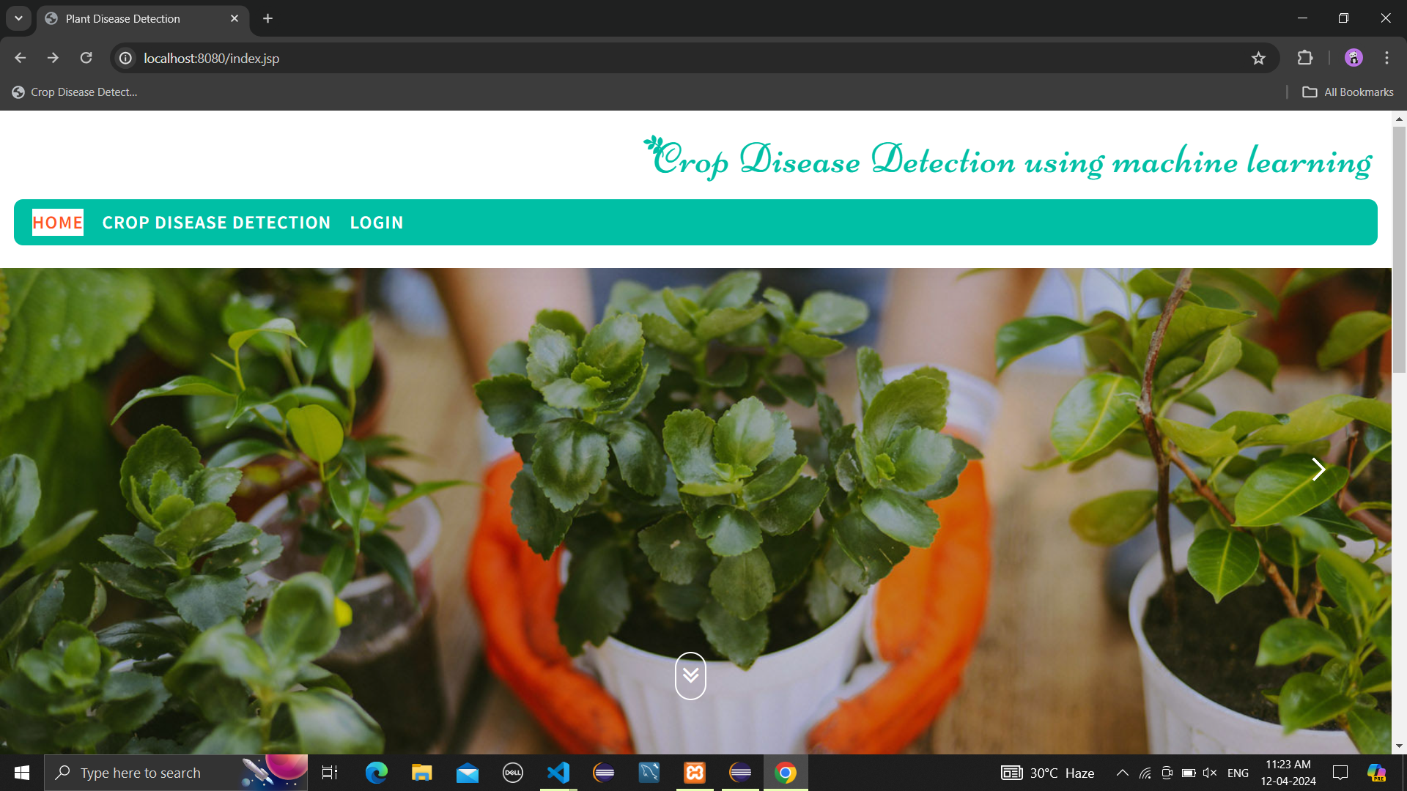
Home page:

Slide 18
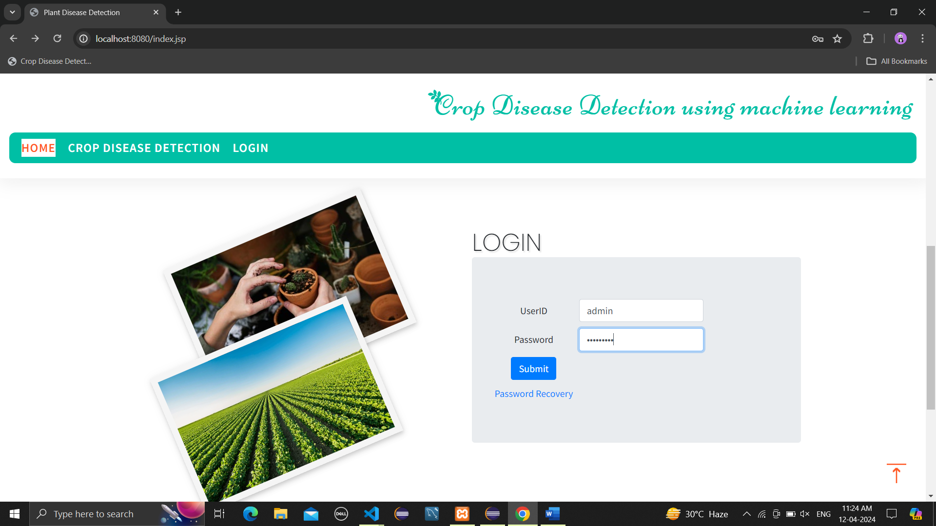
Log-in Page:

Slide 19
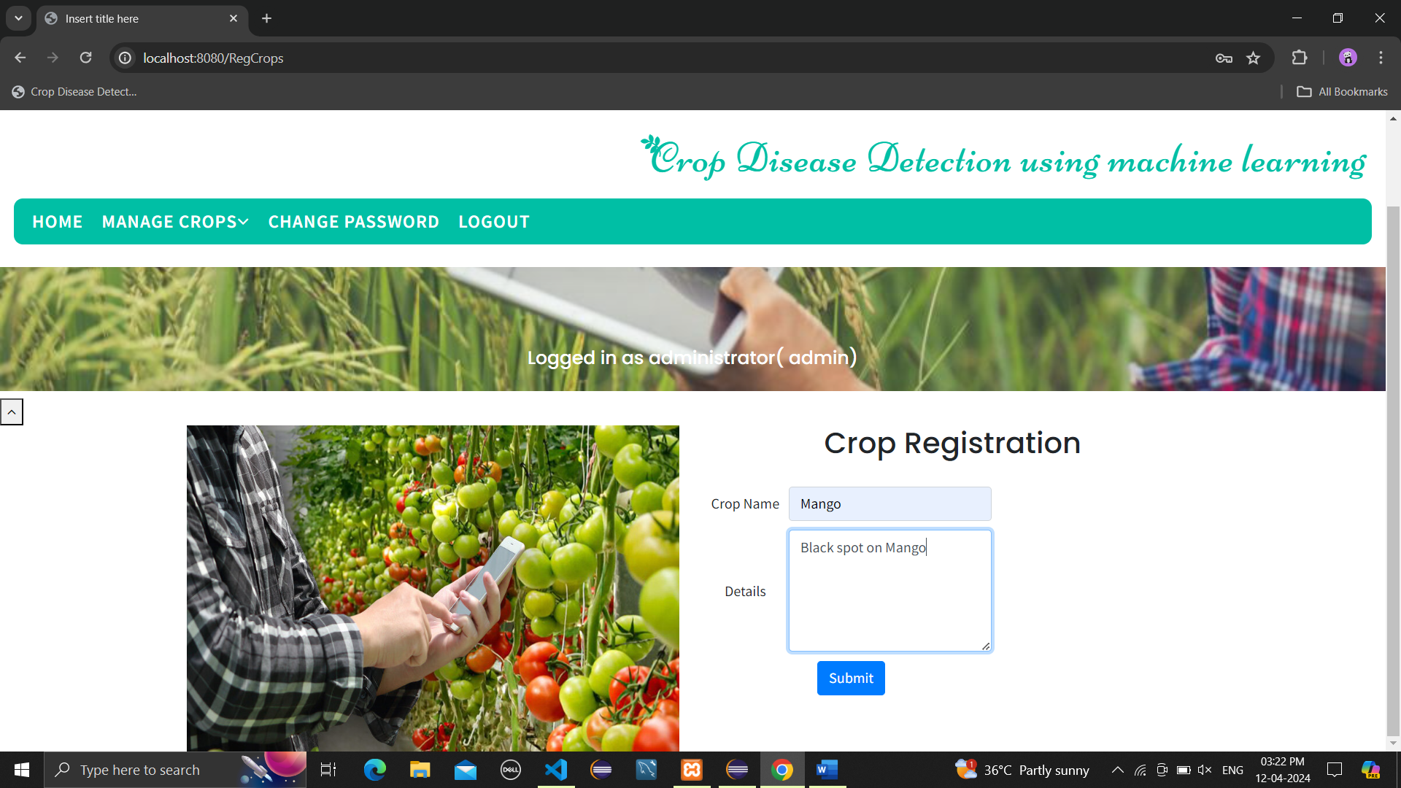
Register Crops:

Slide 20
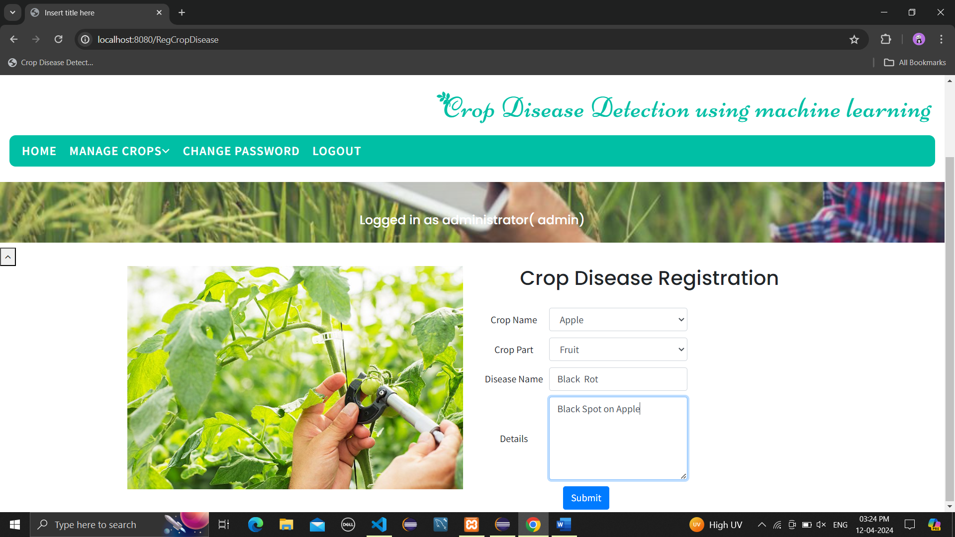
Crop Disease Registration:

Slide 21
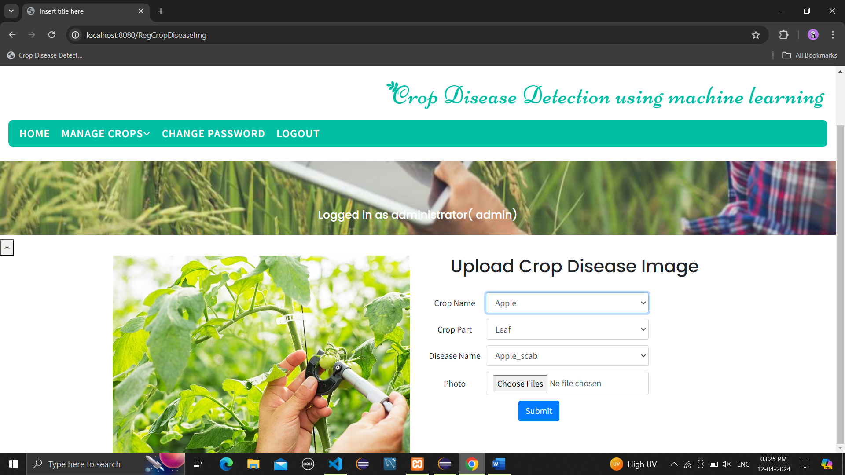
Upload infected crop images:

Slide 22
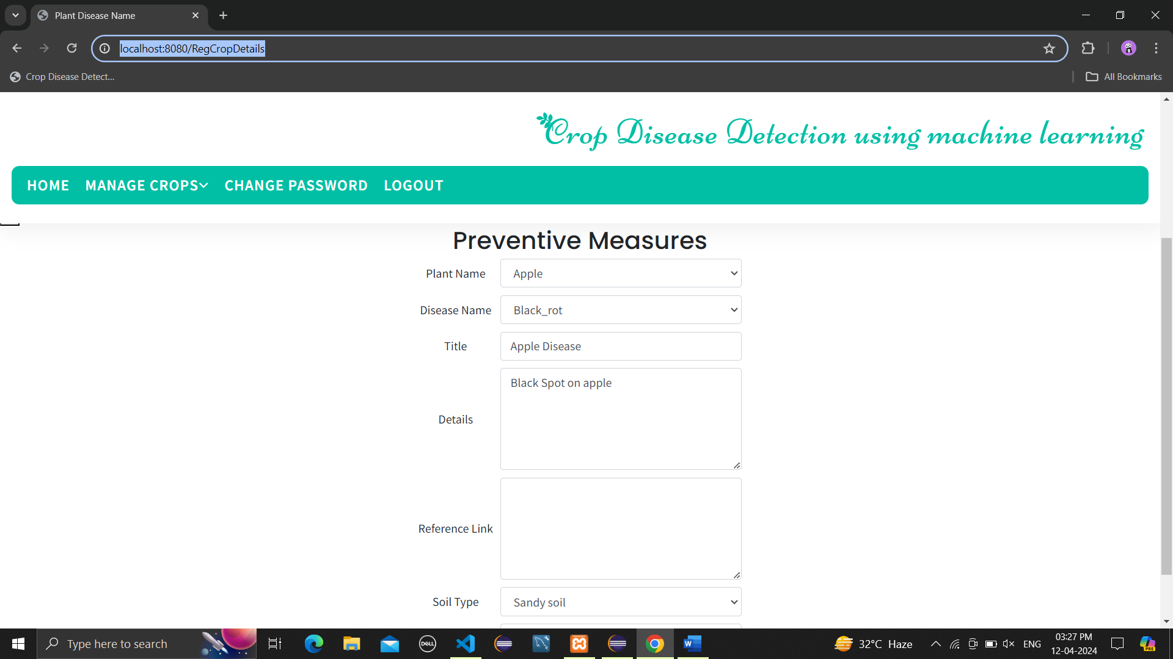
Register Preventive Measures:

Slide 23
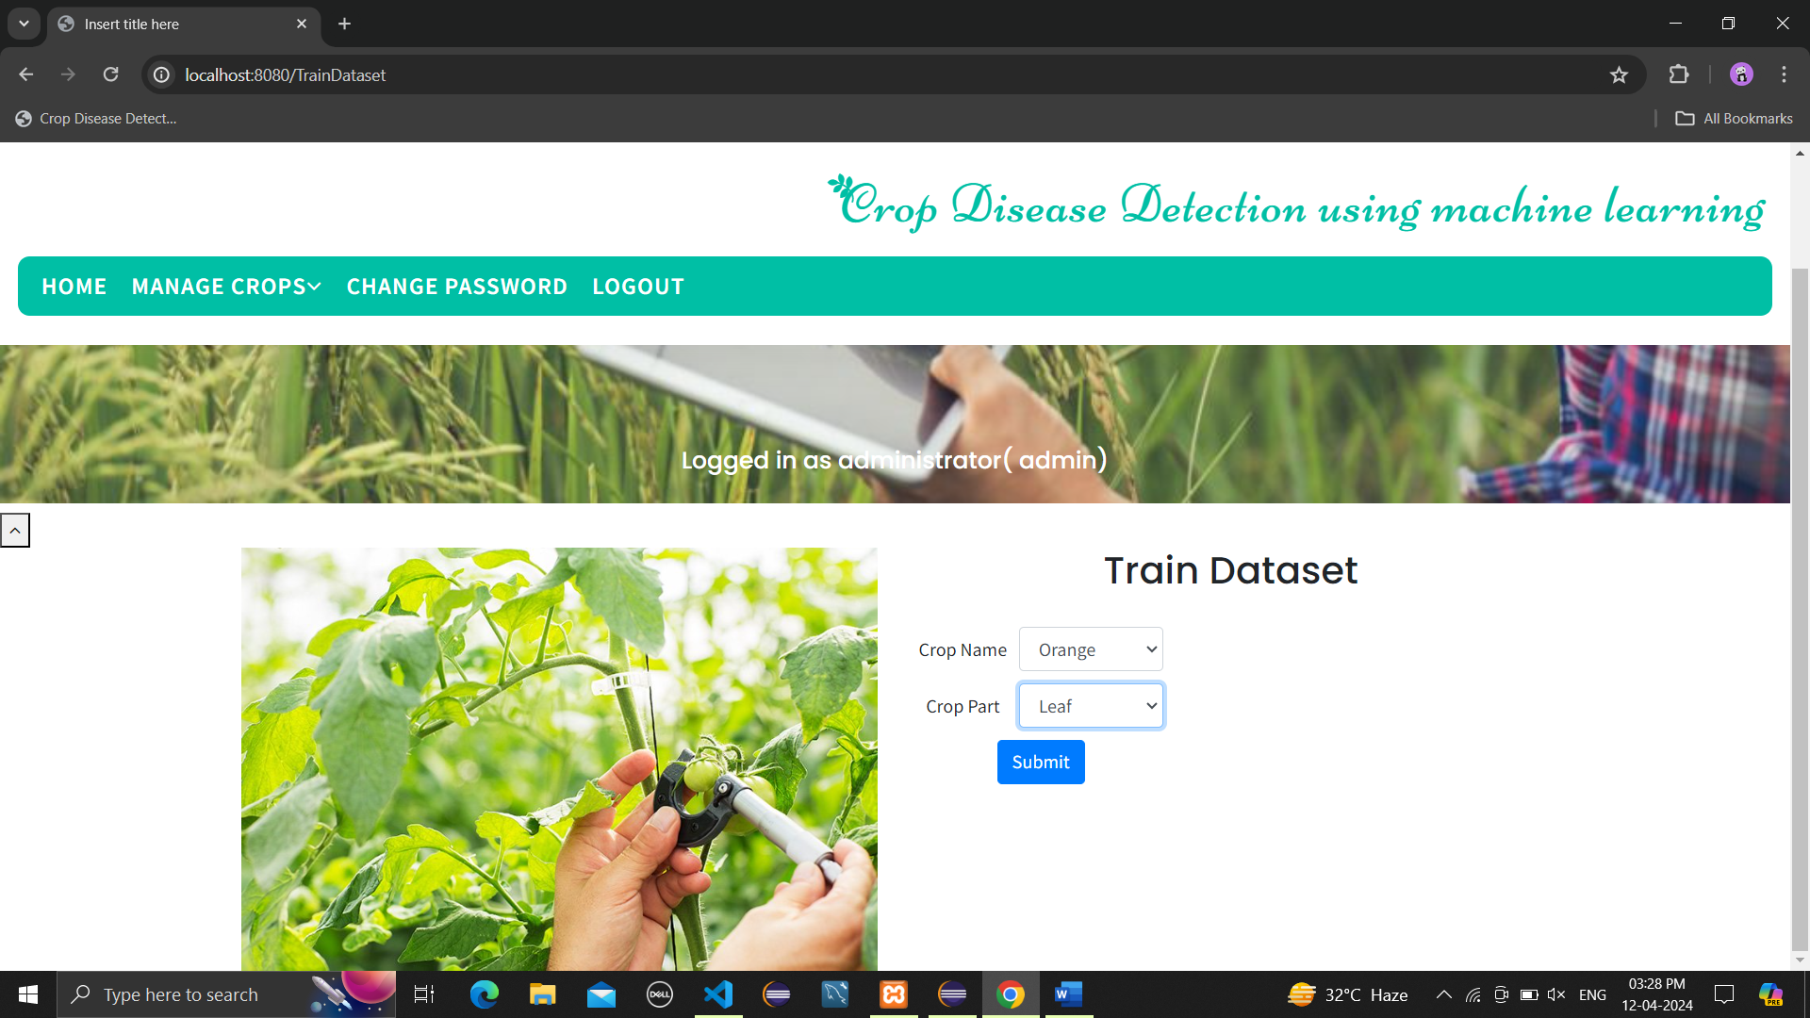
Train Dataset:

Slide 24
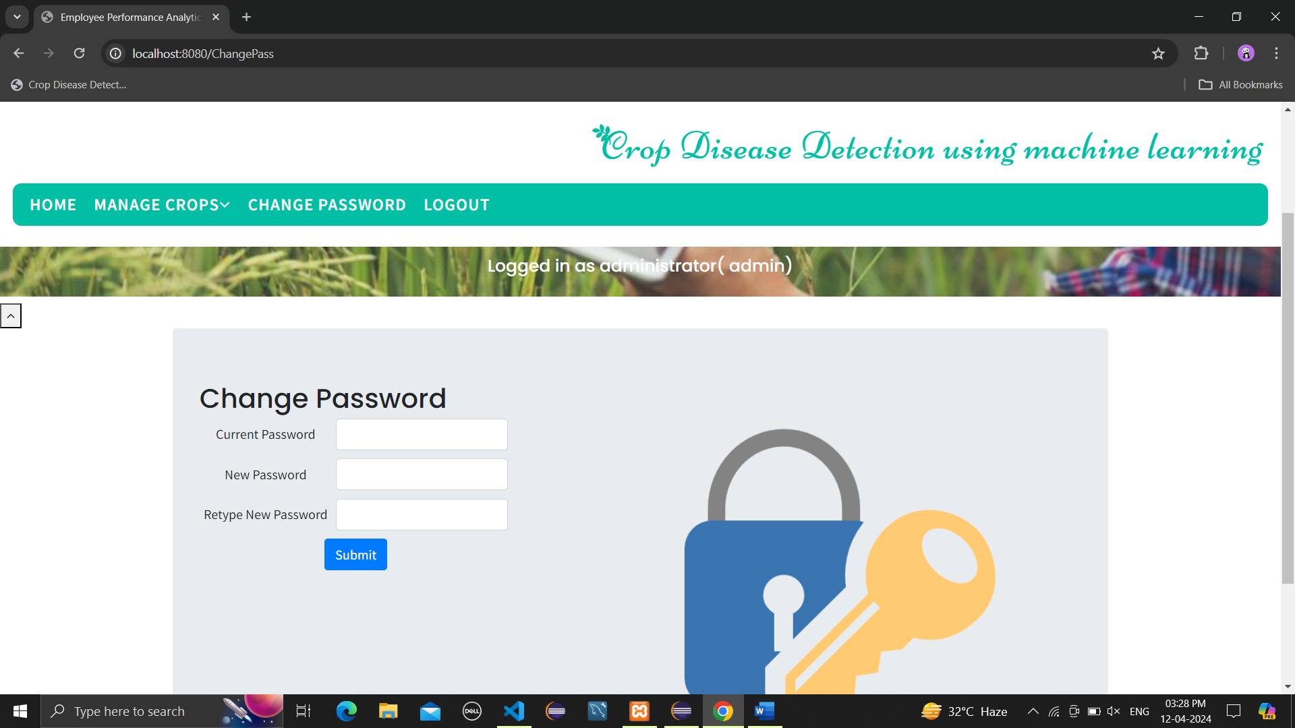
Change Password:

Slide 25
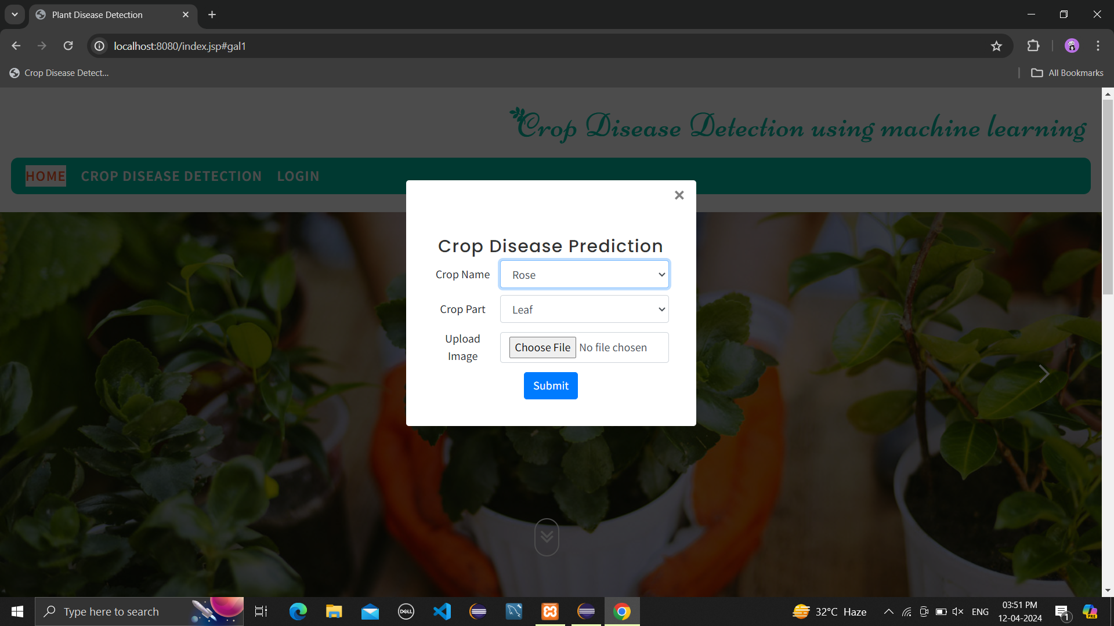
Farmer side home page:

Slide 26
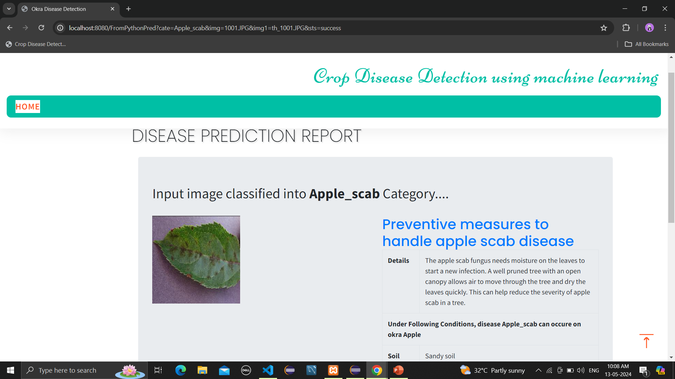
Disease Prediction:

Slide 27
Advantages
Helpful for disease detection.
Easy to use.
As we are using CNN algorithm, Classification will be Highly accurate.
To solve CNN slow training problem, we will save trained model on server.
Farmers will get guidance regarding how to prevent and control the disease with remedies for detected disease.

Slide 28
Disadvantages
Limitation of this seminar is we have to train our system for various datasets.
We are using Convolutional neural network which is significantly slower due to an operation such as maxpool.
If the CNN has several layers, then the training process takes a lot of time if the computer doesn’t consist of a good GPU.
A ConvNet requires a large Dataset to process and train the neural network.
.

Slide 29
Conclusion
In this way, we proposed crop Disease Detection System using image processing.
This system would assist the farmers in identifying the disease detection process faster.
Therefore, we can conclude that our proposed system will be very efficient and faster than existing systems, it is very useful for disease detection.

Slide 30
Future Scope
In this seminar we proposed crop disease prediction and remedies recommender system, in future we can add expert communication module and AI based question answers chatbots for farmers. Along with this we can add the module for possible crop diseases recommendation with the help of environmental changes.

Slide 31
References
Barbedo, J. G. A. (2019). "Factors influencing the use of deep learning for crop disease recognition." Biosystems Engineering, 180, 45-55.
Cruz, A. C., Fuentes, A., & Yoon, S. (2019). "A novel image-based automatic recognition system for crop diseases." Computers and Electronics in Agriculture, 157, 417-428.
Ferentinos, K. P. (2018). "Deep learning models for crop disease detection and diagnosis." Computers and Electronics in Agriculture, 145, 311-318.
Sharma, P., Dhillon, G. S., & Singh, D. (2018). "Disease detection of a crop leaf using Image segmentation with color based K-means clustering." In 2018 IEEE International Conference on Computing, Power and Communication Technologies (GUCON) (pp. 1-6). IEEE.

Slide 32
Thank You !

